Slide 1
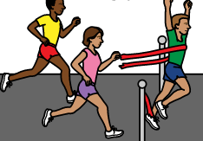
Athletics carnival 2021
Concord Public School

Slide 2
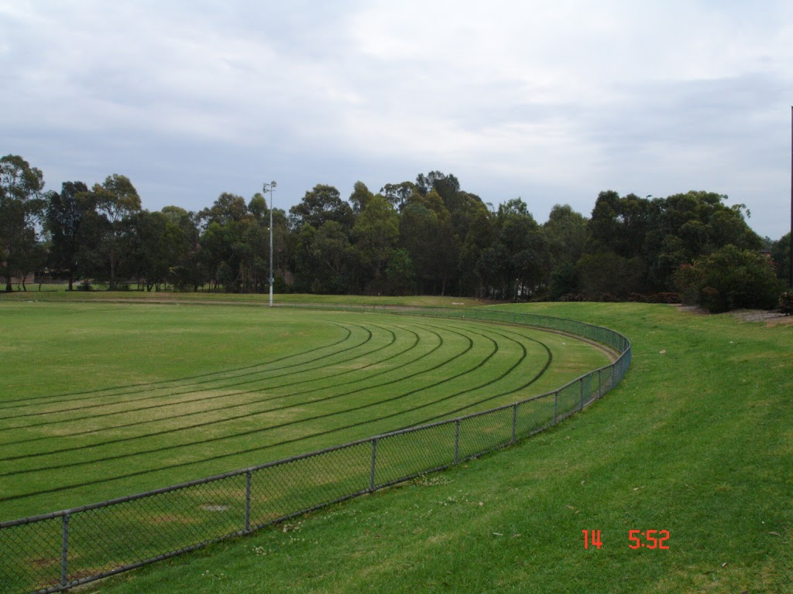
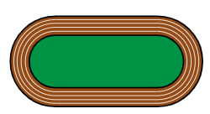
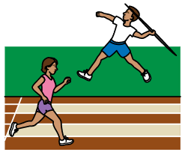
On Wednesday 14th July 2021 we are going to St Luke’s Oval for our Athletics Carnival.
Park
Athletics Carnival

Slide 3
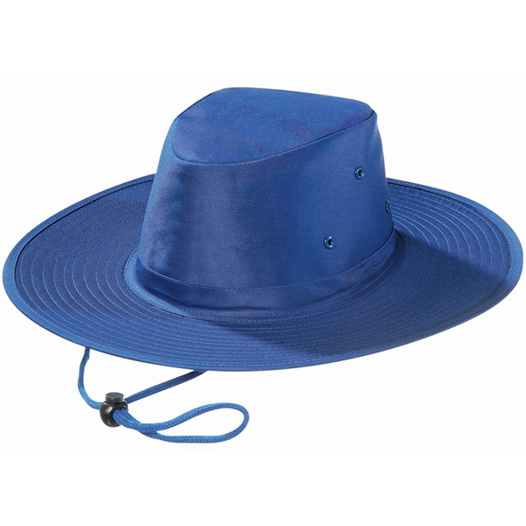
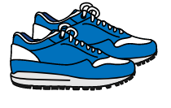
We will wear our house colours, hat and running shoes.
Hat
Running shoes
T-shirt and shorts
Darling will wear red, Hunter will wear green, Lachlan will wear yellow and Murray will wear blue.
Darling
Hunter
Lachlan
Murray

Slide 4
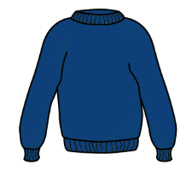
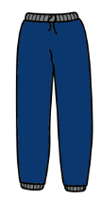
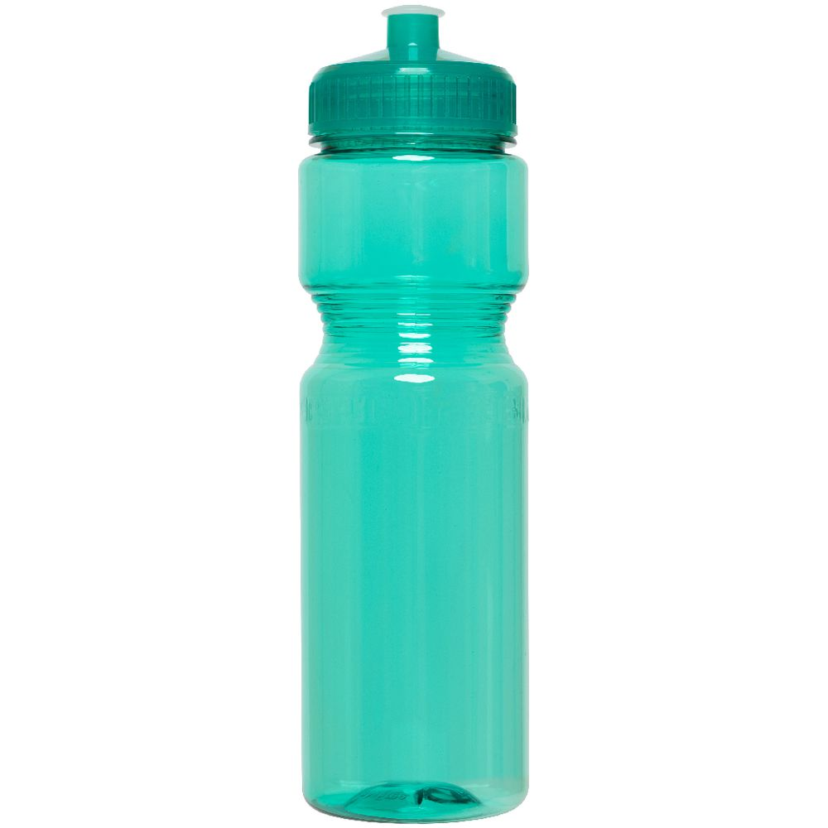
We will bring our lunch box and drink bottle to have lunch and afternoon tea at St Luke’s Oval. If the weather is cold, please bring warm clothes, a towel and a raincoat.
Towel
Jumper
Tracksuit pants
Raincoat
Lunch
Drink bottle

Slide 5
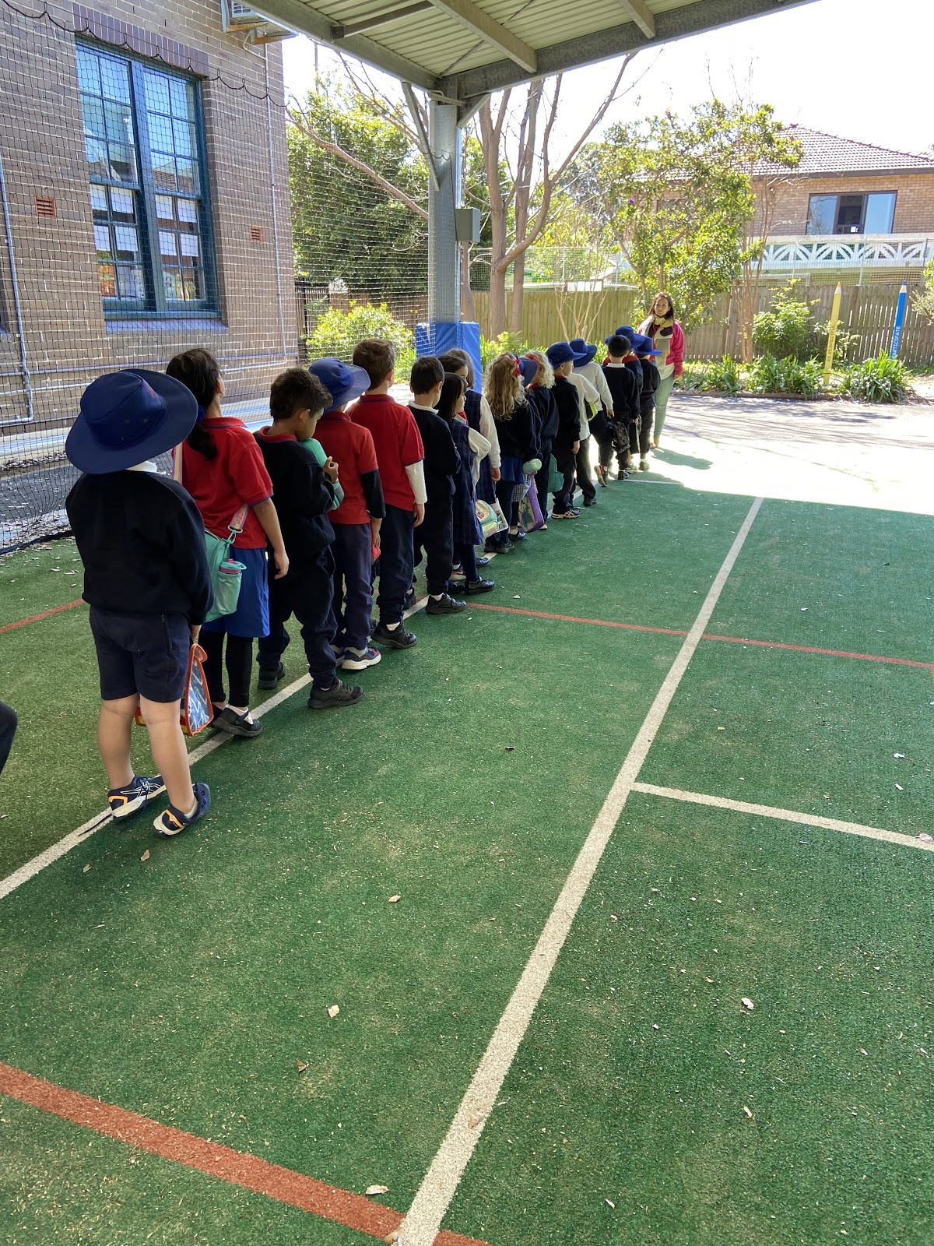
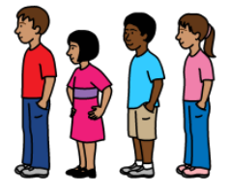
We will line up under the Cola after 9 am.
Wait patiently for your teacher
Use a quiet voice

Slide 6
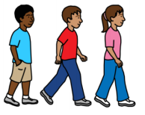
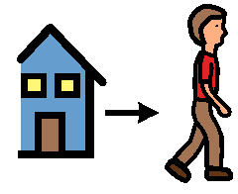
Everyone will walk to St Luke’s Oval with their teachers.
Walk to St Luke’s Oval
Teachers
We will depart school at approximately 9:20am and return at approximately 2:30pm.
Depart
Return

Slide 7
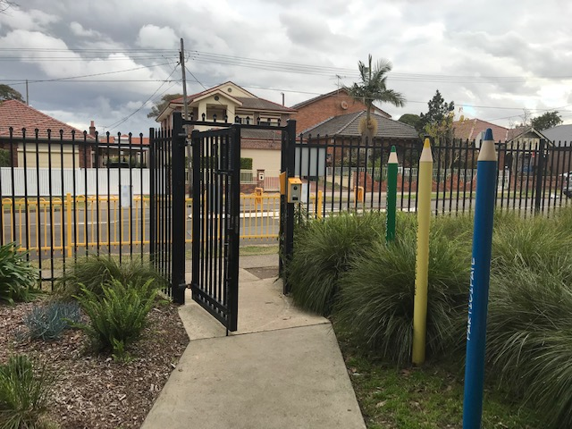
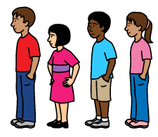
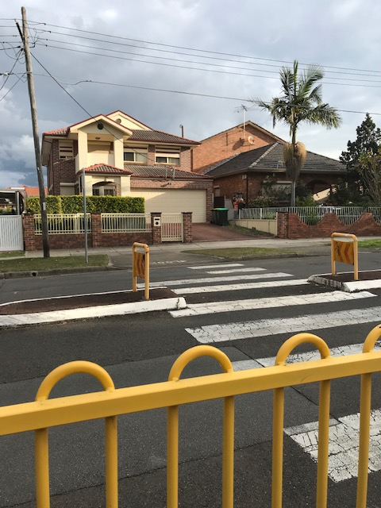
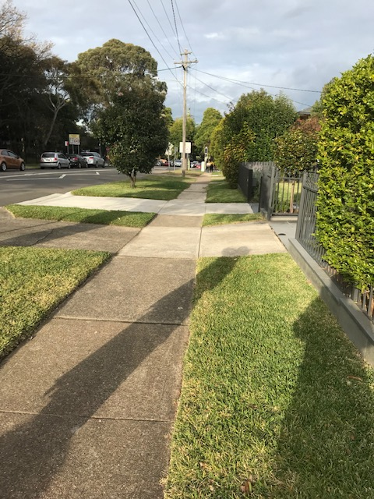
We will leave the school with our teachers by the front gate. We will cross the road at the pedestrian crossing and then walk towards St Luke’s Oval on the footpath.
Walk in a line

Slide 8
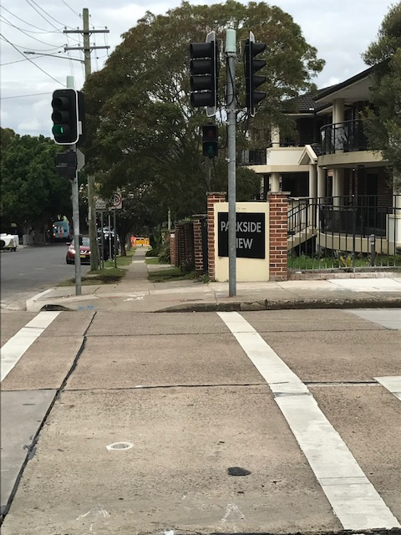
We will stop at the light if the little man is red. When the little man is green it is safe to cross and the teacher will tell you when to walk. I will walk with my buddy, behind my teacher.
Stop
Go

Slide 9
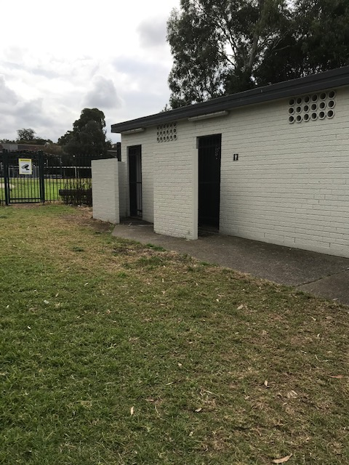
This is where the toilets are. If I need to go to the toilet, I need to ask my teacher first.
Toilets
Ask the teacher

Slide 10
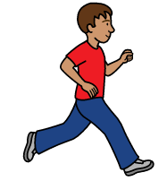
Kindergarten, Year 1 and Year 2 students turning 7 in 2021 will run 70 m around the track.
Run
70 m around the track

Slide 11
Students 8 years, 9 years, 10 years, 11 years, 12 years and 13 years old will run 100 m heats around the track.
Run
100 m around the track

Slide 12
Juniors, 11 year old's and 12 year old's/13 year old's will run 200 m heats around the track.
Run
200 m around the track

Slide 13
Juniors, 11 year old’s, 12 year old’s/13 year old’s will run 800 m heats around the track.
Run
800 m around the track

Slide 14
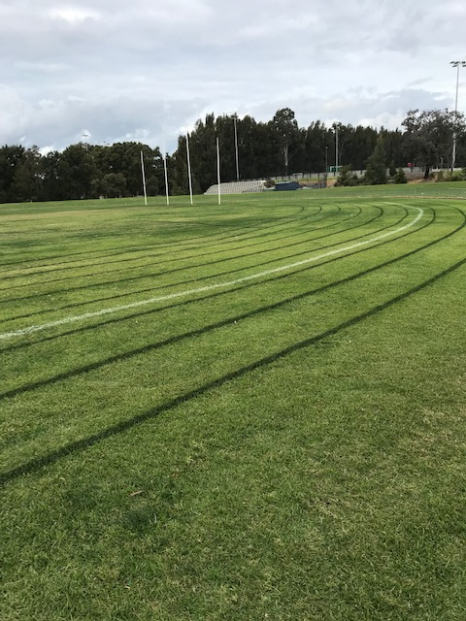
When we run around the track we need to make sure we stay in our lane.
Run
Stay in your lane

Slide 15
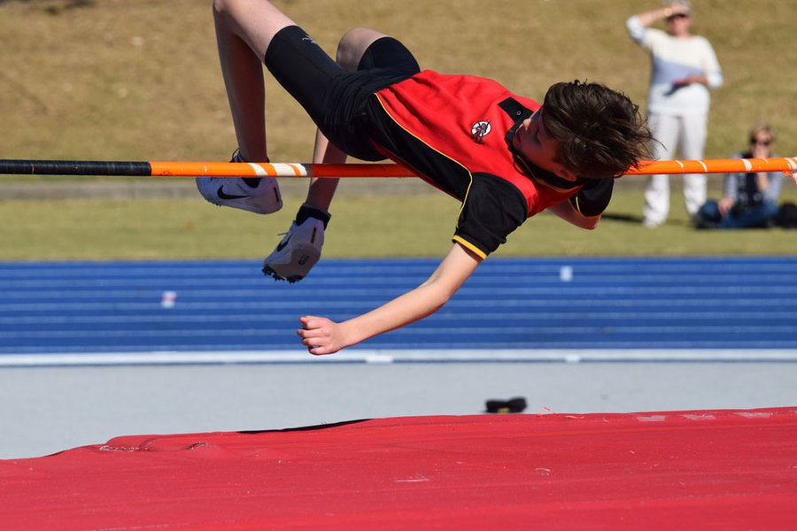
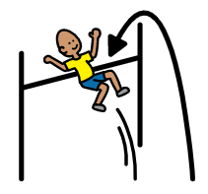
There will be Field Events for students in Years 3-6. High jump will be available for Juniors (8-10 year old’s), 11 years and 12/13 year old's.
High jump
Field Events

Slide 16
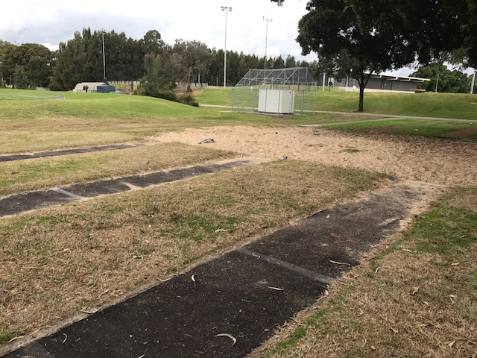
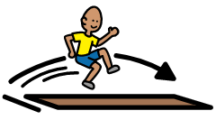
There will be Field Events for students in Years 3-6. Long jump will be available for Juniors (8-10 year old’s), 11 years and 12/13 year old's.
Long jump
Field Events

Slide 17
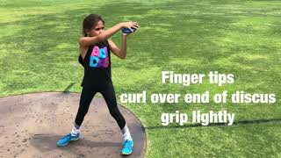
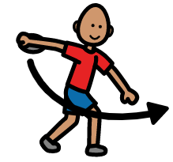
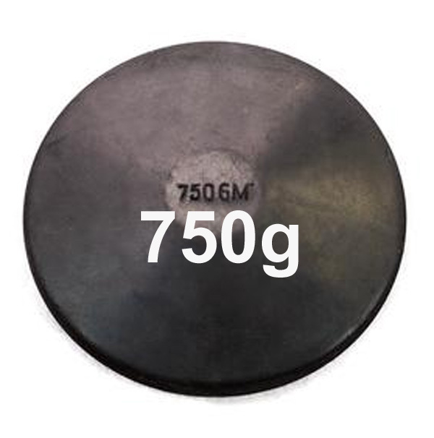
Discus for the Juniors (8-10 year old's) will be 500 grams and discus for 11-13 year old's will be 750 grams.
Discus
Discus

Slide 18
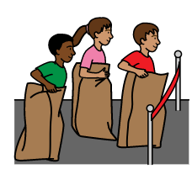
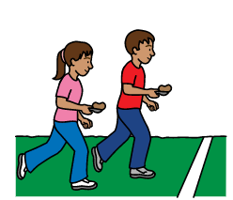
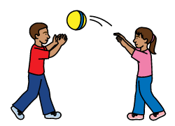
There will be additional Novelty Events and Ball Games on the day.
These activities might be:
Egg and spoon race
Bean bag bounce
Sack race
Bean bags and hoops
Tunnel ball
Sack race
Egg and spoon race
Bean bag activities
Tunnel ball

Slide 19
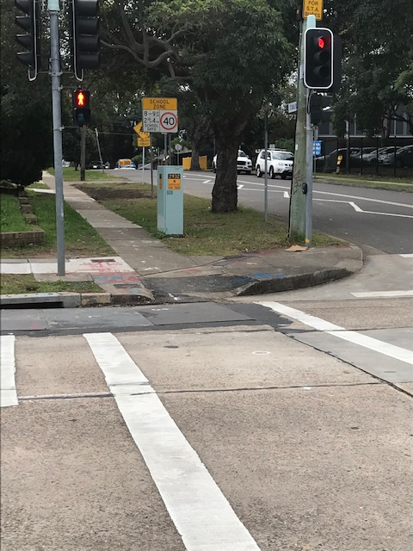
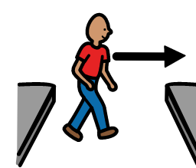
When the Athletics Carnival is finished I will walk back to school with my friends and teachers.
When the little man is green I will walk across the road with my teachers.
Walk across the road
Go

Slide 20
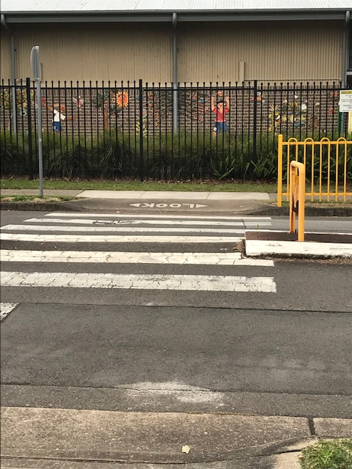
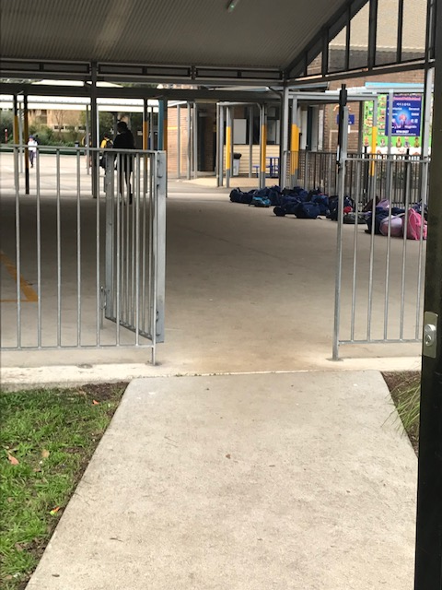
I need to stop at the pedestrian crossing and look left and right. When there are no cars, I can cross the road with my teacher.
Walk across the road

